Slide 1
CPU PERFORMANCE
Alex HosteTler & Dennis Hoang

Slide 2
Our Goal
Create a prediction algorithm that estimates CPU Performance based on its Specifications
The inputs range from various benchmark scores
Which input parameters has the largest impact?
How user benefit from the this prediction?
And does our method answer everything correctly?

Slide 3
Measurements
Data Size: 209
Data Consists of:
MYCT: machine cycle time in nanoseconds (integer)
MMIN: minimum main memory in kilobytes (integer)
MMAX: maximum main memory in kilobytes (integer)
CHMIN: minimum channels in units (integer)
CHMAX: maximum channels in units (integer)

Slide 4

Linear Regression
A statistical method to help compare modeling relationship between variables.
Due to certain parameters that are given, we have a dependent variable yi and independent variables Xip.

Slide 5
Linear Regression
X is our CPU specifications
Only integer-based features (continuous)
Data Parameters including measured performance
Y is our “Published Relative Performance” which is also known as the Benchmark Scores.
Mean Normalization
Gradient Descent
help minimize the functions to which parameters have been set

Slide 6
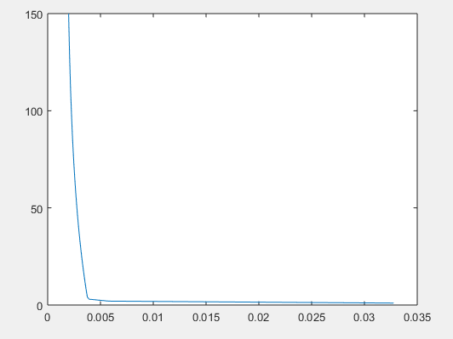
Linear Regression Pt.2
Cost Function

Slide 7
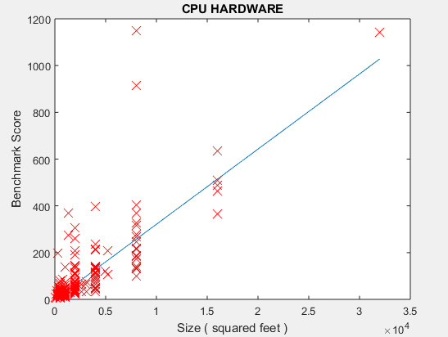
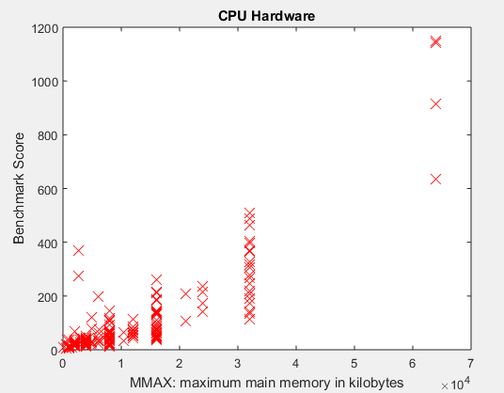
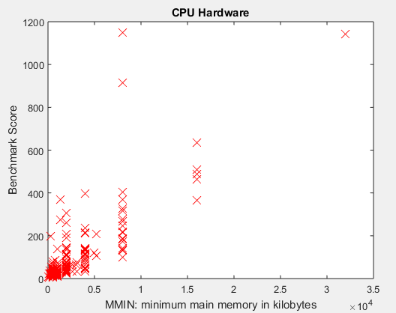
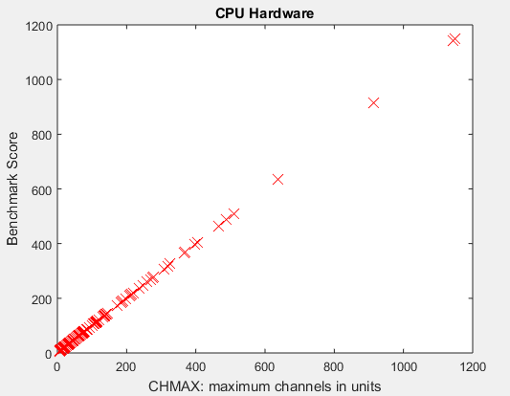
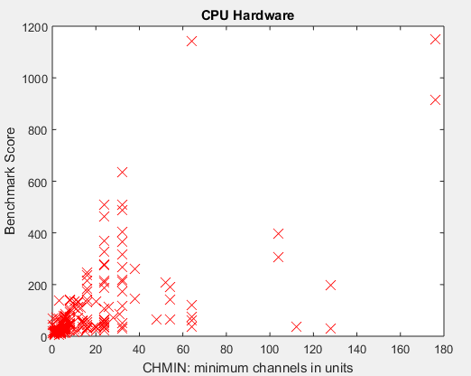
LINEAR REGRESSION PT.3
Our Features

Slide 8
Linear Regression Results
Machine cycle time in nanoseconds | Minimum Main memory in Kilobytes | Maximum main memory in kilobytes | Minimum Channels in units | Maximum channels in units | Published Relative performance | Studies estimated relative performance | Our relative performance
112 | 1000 | 1000 | 1 | 4 | 8 | 19 | 5.4337
220 | 1000 | 8000 | 1 | 2 | 71 | 42 | 41.8306
25 | 2000 | 12000 | 3 | 5 | 66 | 65 | 63.4134
75 | 2000 | 8000 | 1 | 38 | 144 | 75 | 90.6324
60 | 4000 | 16000 | 1 | 6 | 86 | 95 | 84.62

Slide 9
Neural Networks
Contains 3 Types of Layers
Input Layer
Hidden Layers
Output Layer
Caution: having too much hidden layers can cause overfitting
we can figure out the weight of our input and output neurons that we will then train in the neural network. In order to train the neural network we must figure out the error rate. If the error rate is greater than 10% we must re-train and put more weight until it has less than 10% error rate.

Slide 10
Error Rate
Linear Regression
Averaged to be 26% error rate

